Slide 1
IBM University Engagement Project Submission
“Exploring the Power of Agentic AI with IBM Granite and LangFlow”

Slide 2
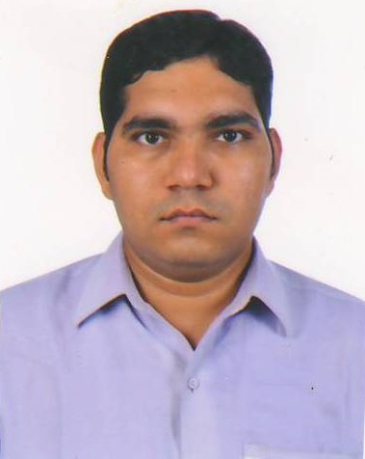
Project Tile – [Agriculture Doctor]
Domain of Project – Agriculture
Student Name | Recent Passport Photo | Email ID | Mobile number [WhatsApp]
JIMESH KUMAR MAHESH KUMAR RANA |  | jmrana@mbit.edu.in | 9879787840

Slide 3
Problem Statement -
Problem Statement : Agriculture Doctor
Farmers often face challenges in identifying crop diseases, pest infestations, nutrient deficiencies, and suitable treatment methods in a timely manner. Due to limited access to agricultural experts, changing weather conditions, and lack of personalized guidance, farmers may experience reduced crop yields, financial losses, and inefficient use of resources such as fertilizers, pesticides, and water.
Traditional agricultural advisory systems provide generic recommendations and cannot continuously analyze multiple factors such as crop health, weather forecasts, soil conditions, and farming practices. Farmers need an intelligent system that can autonomously gather information, analyze agricultural problems, consult multiple knowledge sources, and provide accurate, actionable recommendations.
The proposed Agriculture Doctor leverages Agentic AI to act as a virtual agricultural expert. The system uses specialized AI agents that collaborate to diagnose crop diseases, identify pests and nutrient deficiencies, analyze environmental conditions, and recommend appropriate treatments and preventive measures. By integrating image analysis, weather data, agricultural knowledge bases, and farmer inputs, the system delivers personalized and real-time farming advice.
Objectives
Detect crop diseases and pest infestations from farmer-provided images and descriptions.
Analyze environmental factors such as weather and soil conditions.
Provide treatment recommendations including fertilizers, pesticides, and farming practices.
Suggest preventive measures to reduce future crop losses.
Offer multilingual and easy-to-understand guidance for farmers.
Improve crop productivity and support sustainable agriculture.

Slide 4
Technology Used
Tech Stack (Mandatory)
I used LangFlow + IBM watsonx.ai + Granite Models

Slide 5
Proposed Solution -
Proposed Solution:
The Agriculture Doctor is an Agentic AI-powered agricultural assistant that helps farmers diagnose crop diseases, identify pests and nutrient deficiencies, and receive personalized farming recommendations. The system uses multiple AI agents that collaborate autonomously to analyze farmer inputs, gather relevant information, and provide actionable recommendations.
Built using Langflow and IBM watsonx.ai Granite Models, the solution combines Large Language Models (LLMs), Retrieval-Augmented Generation (RAG), agricultural knowledge bases, weather intelligence, and image analysis to deliver expert-level agricultural support.

Slide 6
Langflow component Used -
1) Chat Input – Interface where users enter their queries, preferences, or meal details (text/voice/image).
2) IBM watsonx AI Agent - Processes user input using Granite models to generate personalized nutrition insights and recommendations.
3) Name of IBM Granite model - Granite-4.0-8B-Instruct → Fast, efficient for real-time diet recommendations
4) Chat output -Displays AI-generated responses such as diet plans, nutritional analysis, and health suggestions.
5) File component - Stores and retrieves user data, meal logs, and nutritional datasets for analysis and tracking.

Slide 7
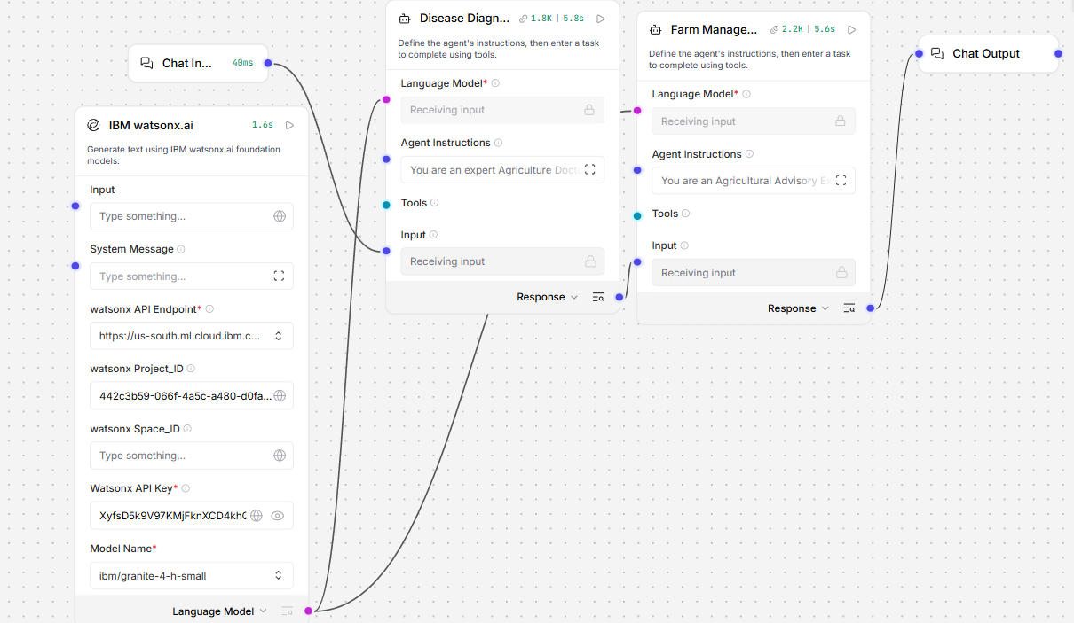
Langflow workflow -

Slide 8
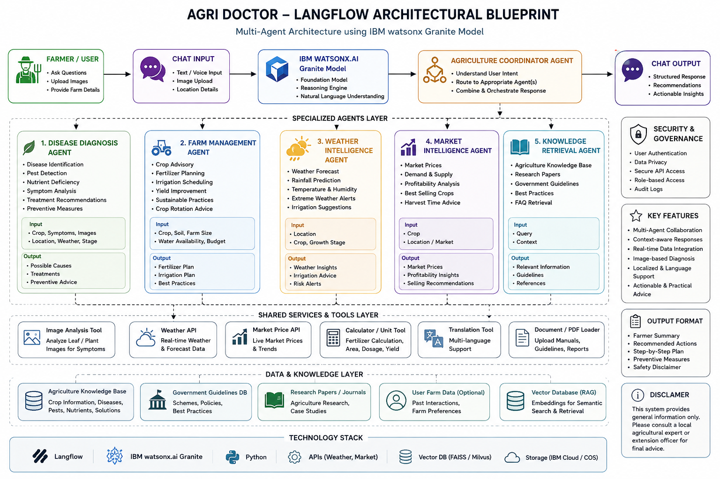
Architecture blueprint

Slide 9

Role of Agentic AI in the solution
Role of Agentic AI in Agriculture Doctor
When a farmer submits a crop image or describes a problem, the Agentic AI system:
Understands the farmer's query.
Identifies the crop and symptoms.
Retrieves relevant agricultural knowledge.
Analyzes weather and environmental conditions.
Diagnoses possible diseases or pest infestations.
Generates treatment and prevention recommendations.
Provides a comprehensive advisory report.
This autonomous decision-making process makes the system more intelligent and effective than conventional agricultural support systems.

Slide 10
Technology Used
Langflow platform -For designing and orchestrating multi-agent workflows visually
IBM Grainte model - for eg – ibm-granite-3-2-8b – For natural language understanding, reasoning, and personalization
IBM Cloud – It provides the infrastructure to build, deploy, and scale the Nutrition Agent efficiently. IBM Cloud enables a reliable, secure, and scalable environment for deploying the Nutrition Agent.
IBM Watsonx.ai - For model deployment, embeddings, and AI governance

Slide 11
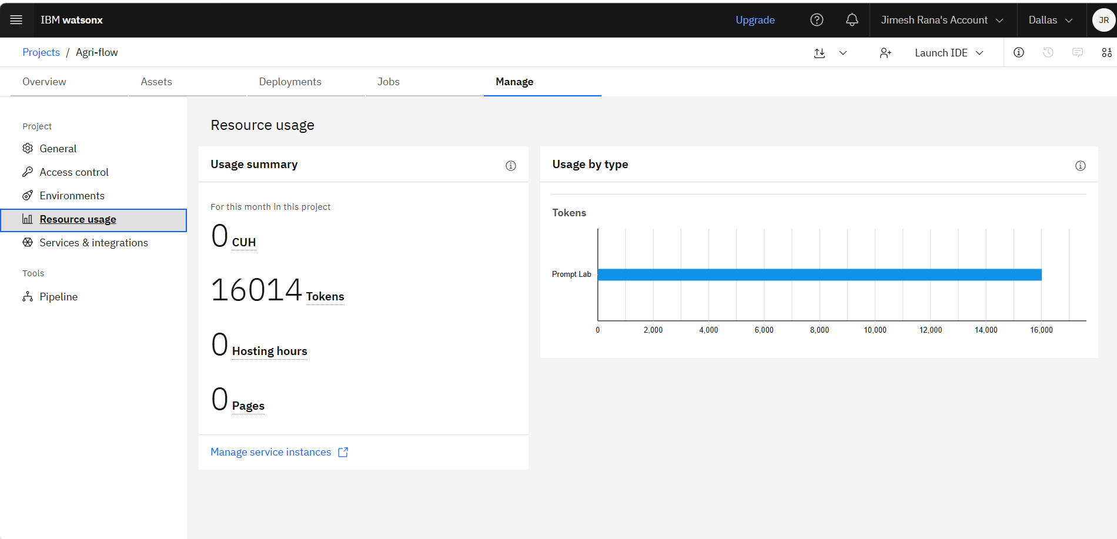
Token Usage
·
·
·

Slide 12
Novelty and Uniqueness of Agriculture Doctor using Agentic AI
Novelty
The proposed Agriculture Doctor introduces an innovative approach to digital farming assistance by combining Agentic AI, Large Language Models (LLMs), Retrieval-Augmented Generation (RAG), Computer Vision, and Real-Time Weather Intelligence into a single intelligent agricultural ecosystem. Unlike traditional agricultural advisory systems that provide static and generic recommendations, the Agriculture Doctor can autonomously analyze, reason, and make context-aware decisions using multiple collaborating AI agents.
The system acts as a virtual agricultural expert capable of diagnosing crop diseases, retrieving relevant agricultural knowledge, evaluating environmental conditions, and generating personalized treatment recommendations for farmers in real time.
1. Multi-Agent Collaborative Intelligence
Unlike conventional chatbots that rely on a single AI model, Agriculture Doctor employs multiple specialized agents working together:
Crop Diagnosis Agent
Pest Detection Agent
Weather Analysis Agent
Knowledge Retrieval Agent
Advisory Agent
Each agent performs a specific task and collaborates with other agents to provide accurate recommendations.
Unique Value: Simulates the decision-making process of a team of agricultural experts rather than a single advisory system.
2. Agentic AI-Based Autonomous Decision Making
Most agricultural applications require users to manually search for solutions.
Agriculture Doctor:
Understands the farmer's problem.
Decides which information is needed.
Retrieves agricultural knowledge.
Analyzes weather conditions.
Generates treatment plans autonomously.
Unique Value: The system actively reasons and plans actions instead of merely answering questions.

Slide 13
Git Hub Link
· http://github.com/jimesh12/IBM-project
·
·
·

Slide 14
Future Scope
The Agriculture Doctor system has significant potential for future expansion and can evolve into a comprehensive smart farming platform. By integrating advanced AI technologies, IoT devices, drones, and predictive analytics, the system can provide even more intelligent and proactive agricultural support.
·
·
·

Slide 15


